Slide 1
Cell Type-wise SDAE Biomarker Discovery
GSE183276 single-cell kidney data | AKI, CKD, Ref | PT, TAL, IMM, EC, IC, PC, CNT, DCT
Dataset
109,741 cells
37,080 genes
metadata-driven analysis
Model
Supervised Denoising Autoencoder
3000 HVG input
latent dimension = 32
Output
Cell-wise biomarkers
AKI / CKD / Ref genes
metrics + plots + tables
Goal: identify condition-specific genes inside each kidney cell type using model importance and expression difference together.

Slide 2
Study Design
What data entered the pipeline and how labels were selected
Condition column
condition.l1
AKI, CKD, Ref
Cell type column
subclass.l1
PT, TAL, IMM, EC, IC, PC, CNT, DCT
Per-cell-type loop
Each cell type processed separately
separate HVGs, model weights, biomarkers
Important interpretation
The architecture is the same for all selected cell types, but the training data, selected HVG set, learned weights, performance metrics, and biomarker genes are different for each cell type.

Slide 3
Parameter Block
What each group of notebook settings controls
Metadata
CONDITION_COL
CELLTYPE_COL
Targets
TARGET_CLASSES
TARGET_CELL_TYPES
Feature + Split
N_TOP_HVG = 3000
TEST_SIZE, VAL_SIZE
Training
BATCH_SIZE, EPOCHS
PATIENCE, LR, WD
Model + Biomarkers
NOISE, HIDDEN, LATENT
TOP_N, MAX_CELLS
Balancing
Use Ref count when possible
No oversampling replacement
otherwise use minimum count
Loss
Reconstruction weight = 1.0
Classification weight = 1.5
condition prediction emphasized
Biomarker output
Top 200 genes per class
Gradient x Input uses up to 400 cells
ranked by combined score

Slide 4
Total Workflow
From raw single-cell matrix to final cell type-wise biomarker tables
Load data
expression matrix + metadata
Filter targets
AKI, CKD, Ref + selected cell types
Balance classes
equal cells per condition
Select HVGs
top 3000 by variance
Train SDAE
denoising + classification
Evaluate
accuracy, F1, confusion matrix, PCA
Rank genes
Gradient x Input + expression difference
The loop repeats for PT, TAL, IMM, EC, IC, PC, CNT, and DCT. Final tables concatenate the top biomarkers from all cell types and classes.

Slide 5
SDAE Architecture
Same architecture is used for every selected cell type
Input
3000 HVG genes
Noise
random masking p=0.20
Encoder
3000 -> 512 -> 128 -> 32
Latent
z = 32
Decoder
32 -> 128 -> 512 -> 3000
Classifier
32 -> 64 -> AKI/CKD/Ref
Training objective combines reconstruction and classification: MSE encourages robust representation, CrossEntropy learns disease condition prediction.

Slide 6
Gene Importance Logic
How biomarkers are scored, not just predicted
Target class
AKI or CKD or Ref
Class logit
use classifier score before softmax
Gradient
d(logit) / d(gene)
Gradient x Input
importance = sensitivity x expression
Expression direction
target mean - others mean
Combined score
importance x abs(diff)
A high-ranked gene is both useful for the trained classifier and strongly different in the target condition compared with the other two conditions.

Slide 7
Balanced Cell Counts
Cell count used after within-cell-type class balancing
Cell
Balanced cells
Rule
PT
15549
Ref count used
Why balancing matters
Prevents dominant condition from controlling training
Makes AKI, CKD, Ref comparison fairer
Avoids replacement oversampling in this setup
TAL
10935
Ref count used
IMM
4419
Ref count used
EC
5745
minimum condition count used
IC
3330
minimum condition count used
PC
2478
Ref count used
CNT
4749
minimum condition count used
DCT
2472
minimum condition count used

Slide 8
Model Performance
Test performance across cell type-specific SDAE models
Cell
Accuracy
Macro F1
Best val F1
Epochs
Overall pattern
Most cell type-specific models achieved strong macro F1
PT and CNT were among the highest-performing models
IMM was comparatively lower but still learned useful signal
CNT
0.924
0.925
0.922
14
DCT
0.869
0.870
0.891
14
EC
0.870
0.870
0.881
30
IC
0.893
0.895
0.923
17
IMM
0.833
0.833
0.835
12
PC
0.905
0.905
0.892
10
PT
0.936
0.936
0.940
19
Use in biomarker discovery
Performance supports using classifier gradients
Biomarkers should still be interpreted biologically
TAL
0.899
0.900
0.912
9

Slide 9
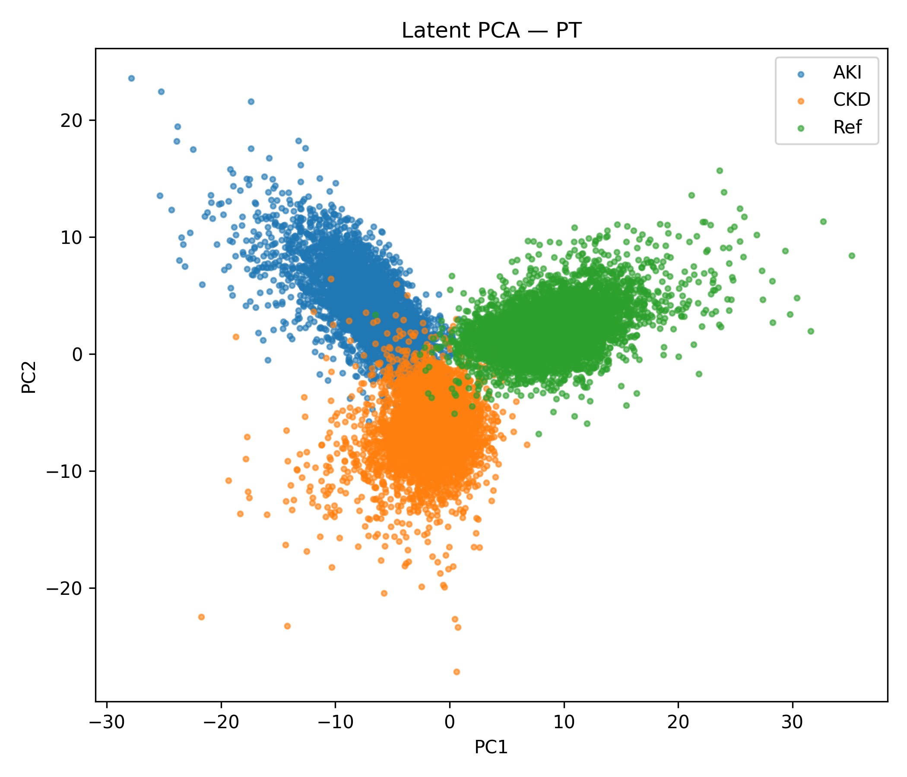
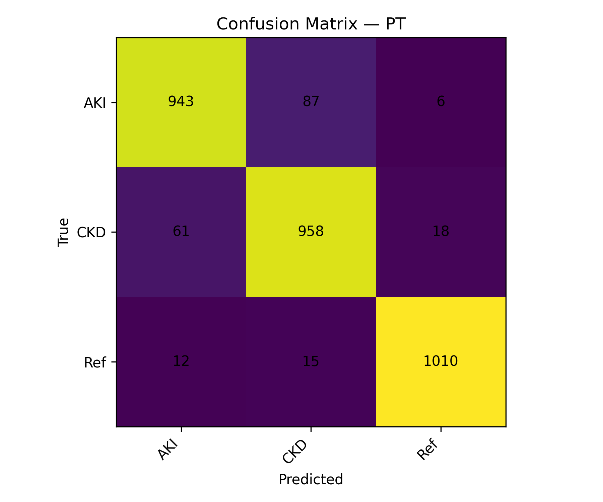
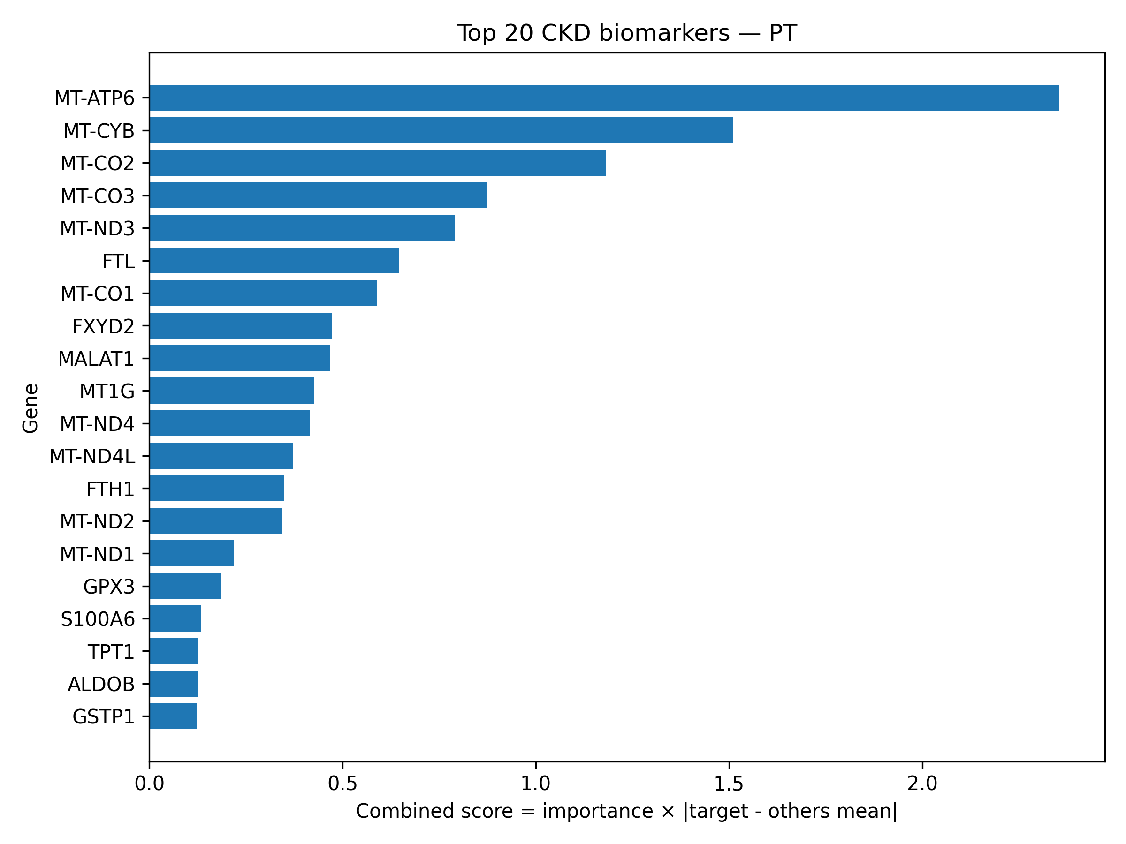
Example Output Plots
Saved figures produced by the notebook
PT latent PCA
PT confusion matrix
PT CKD top biomarkers
Similar plots are saved for every selected cell type with prefix celltype_<CELLTYPE>__...

Slide 10
Final Biomarker Tables
How to read the saved results
ALL_celltype_top_biomarkers
Top ranked genes per cell type
separate class labels
AKI, CKD, Ref
FINAL_compact_celltype_biomarkers
Report-friendly compact table
gene, class, score, importance
mean expression columns
Per-cell files
HVG list, metrics, confusion matrix
latent representation
trained model weights
Columns to explain: importance = Gradient x Input model relevance; target_minus_others_mean = expression difference; combined_score = final ranking score combining both.

Slide 11
Take-home Message
What this workflow contributes
Cell type-wise modeling avoids mixing biologically different kidney compartments.
The SDAE learns robust latent features while also predicting AKI, CKD, and Ref.
Biomarkers are prioritized by both model importance and condition-specific expression shift.
Result: separate AKI, CKD, and Ref biomarker candidates for PT, TAL, IMM, EC, IC, PC, CNT, and DCT.

